Slide 1

Data Analysis Project : Sleep Health And Lifestyle Analysis

Slide 2
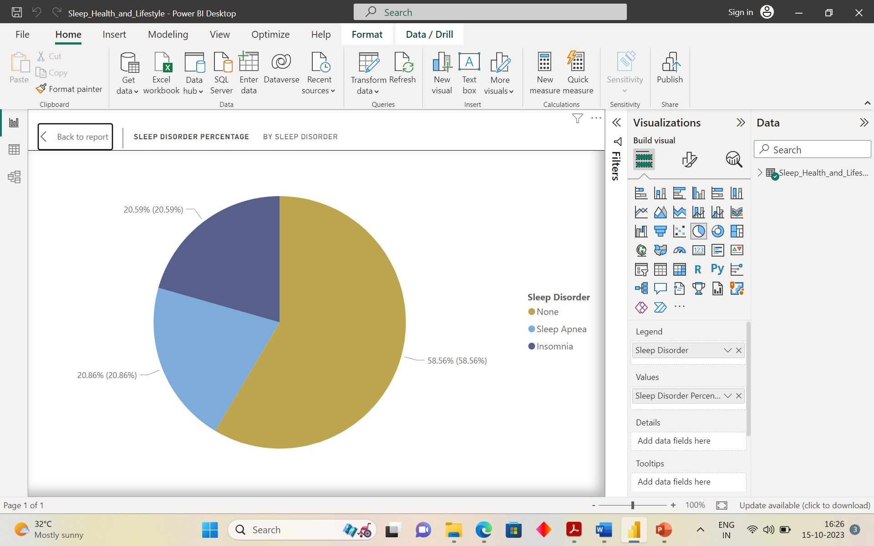
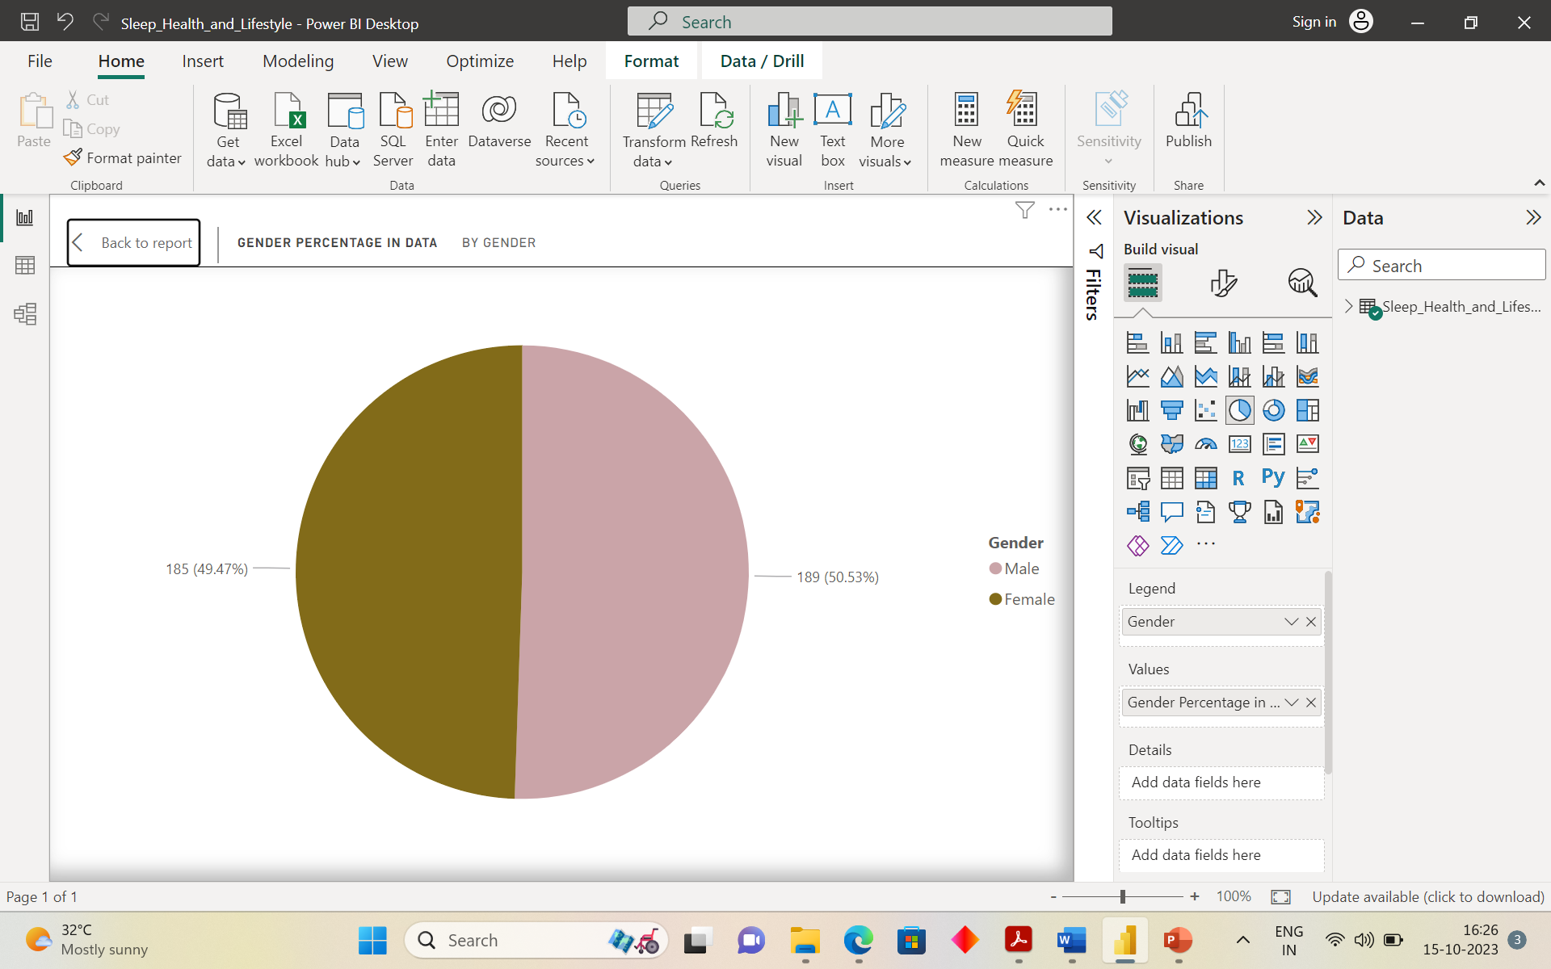
From the above two pie charts, we can observe several pieces of information.
Firstly, the highest percentage in the sleep disorder is the None indicating that a significant portion of data does not have reported sleep disorder. The second highest sleep disorder is “Sleep Apnea”.
In the Second Pie chart depicting percentage, the male percentage is higher than the female percentage.

Slide 3
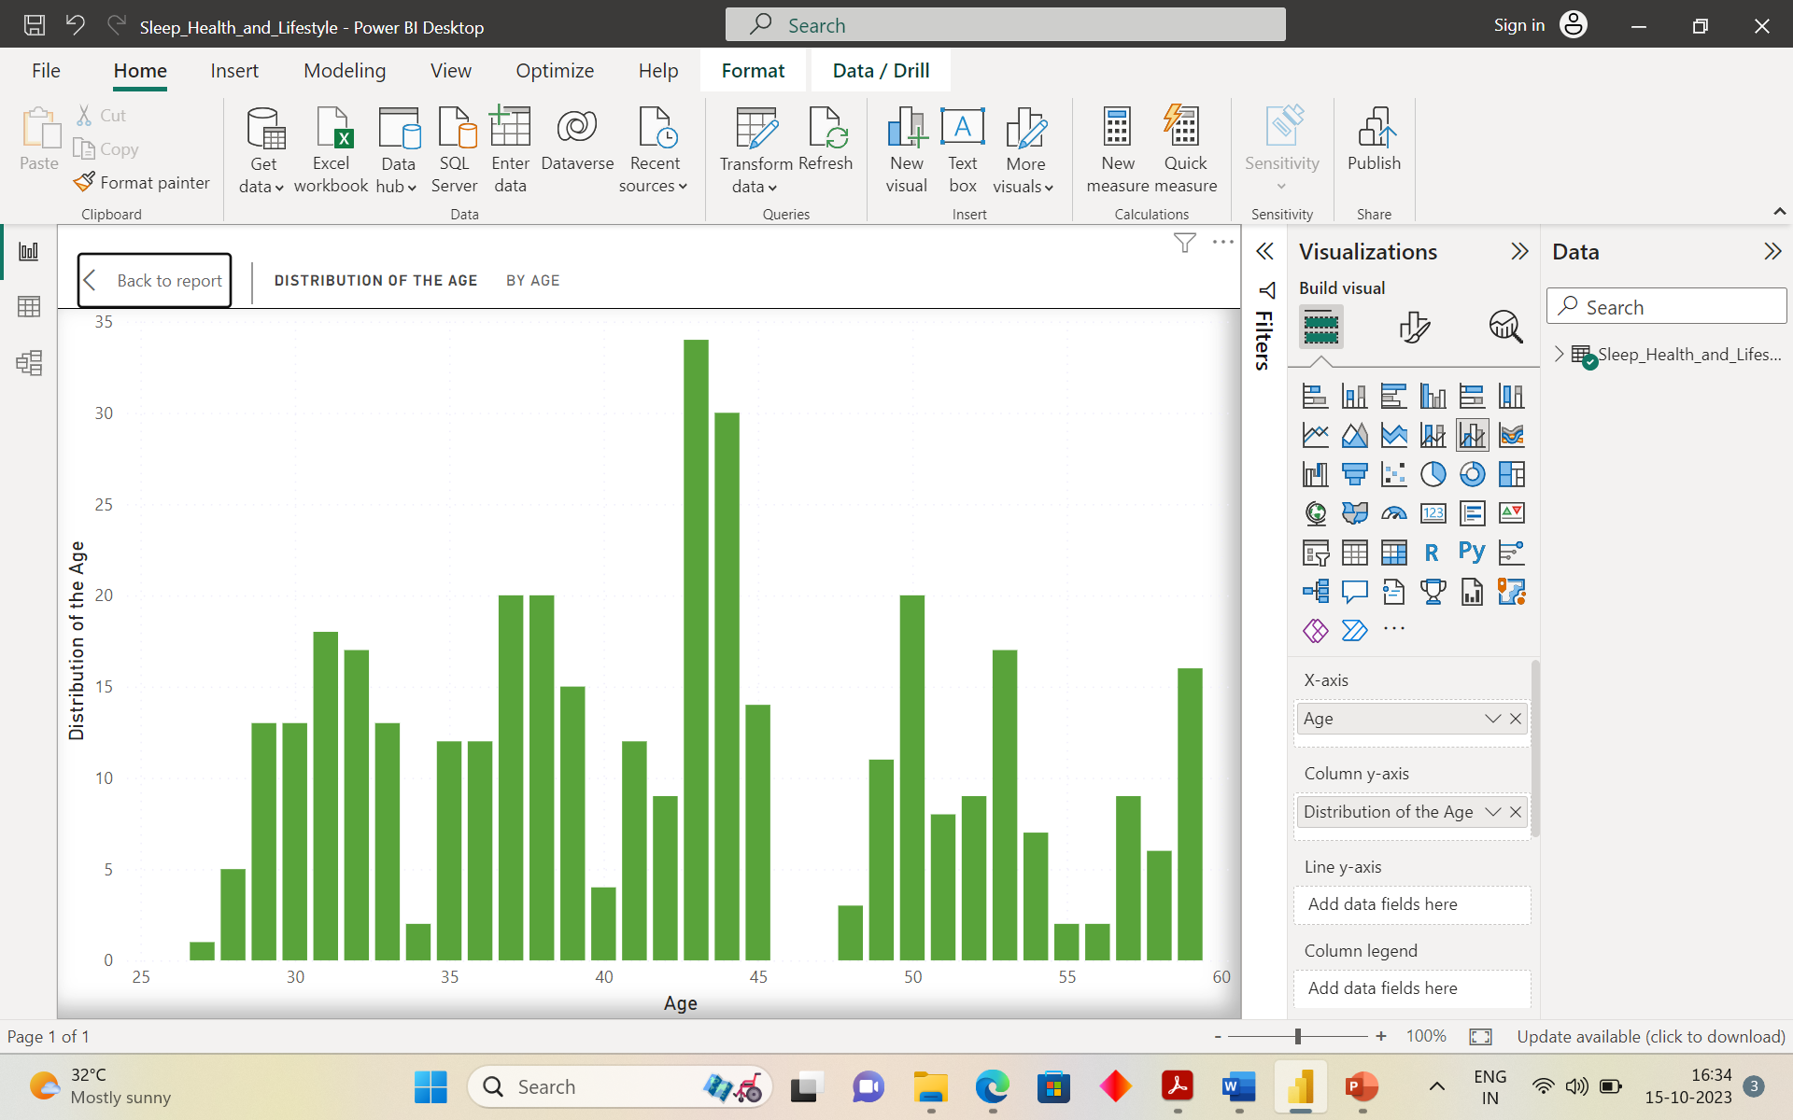
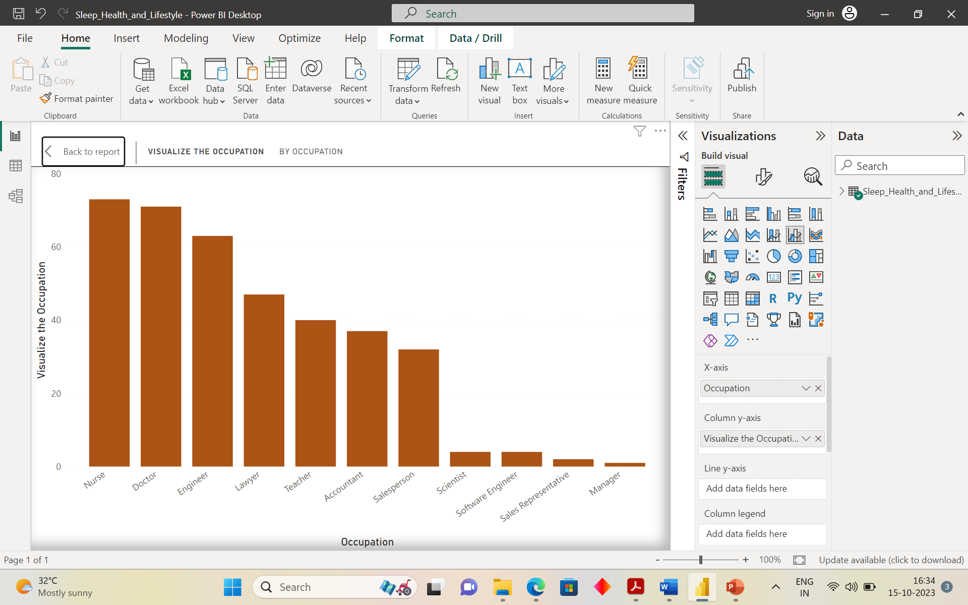
From the above two charts, we can observe the following patterns :
There is noticeable repition of age 43, indicationg that a significant number of individuals in the data set falls within age this range.
In the bar chart, we can determine that the most demanding job based on the data set is “Nurse”, while the least demanding job is “Manager”.

Slide 4
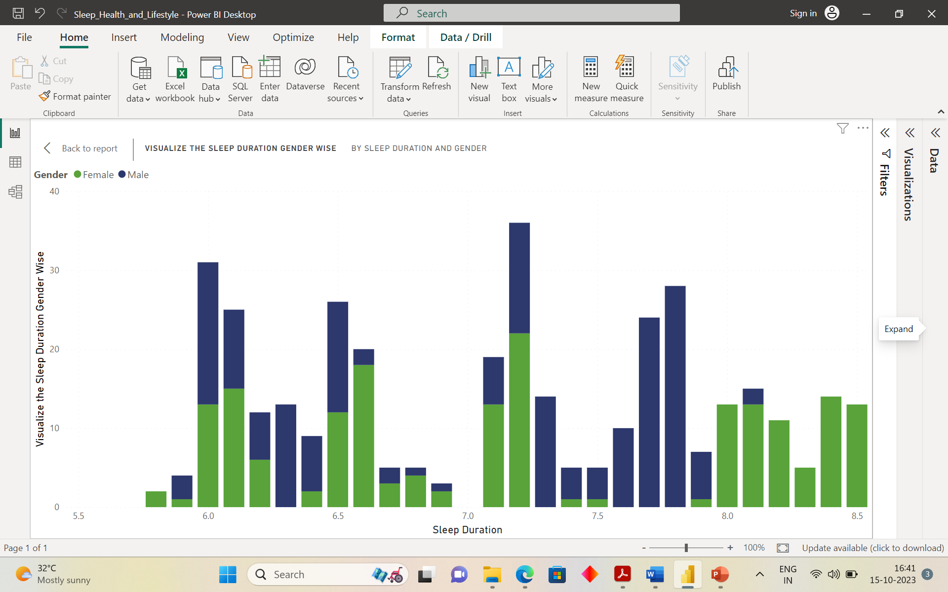
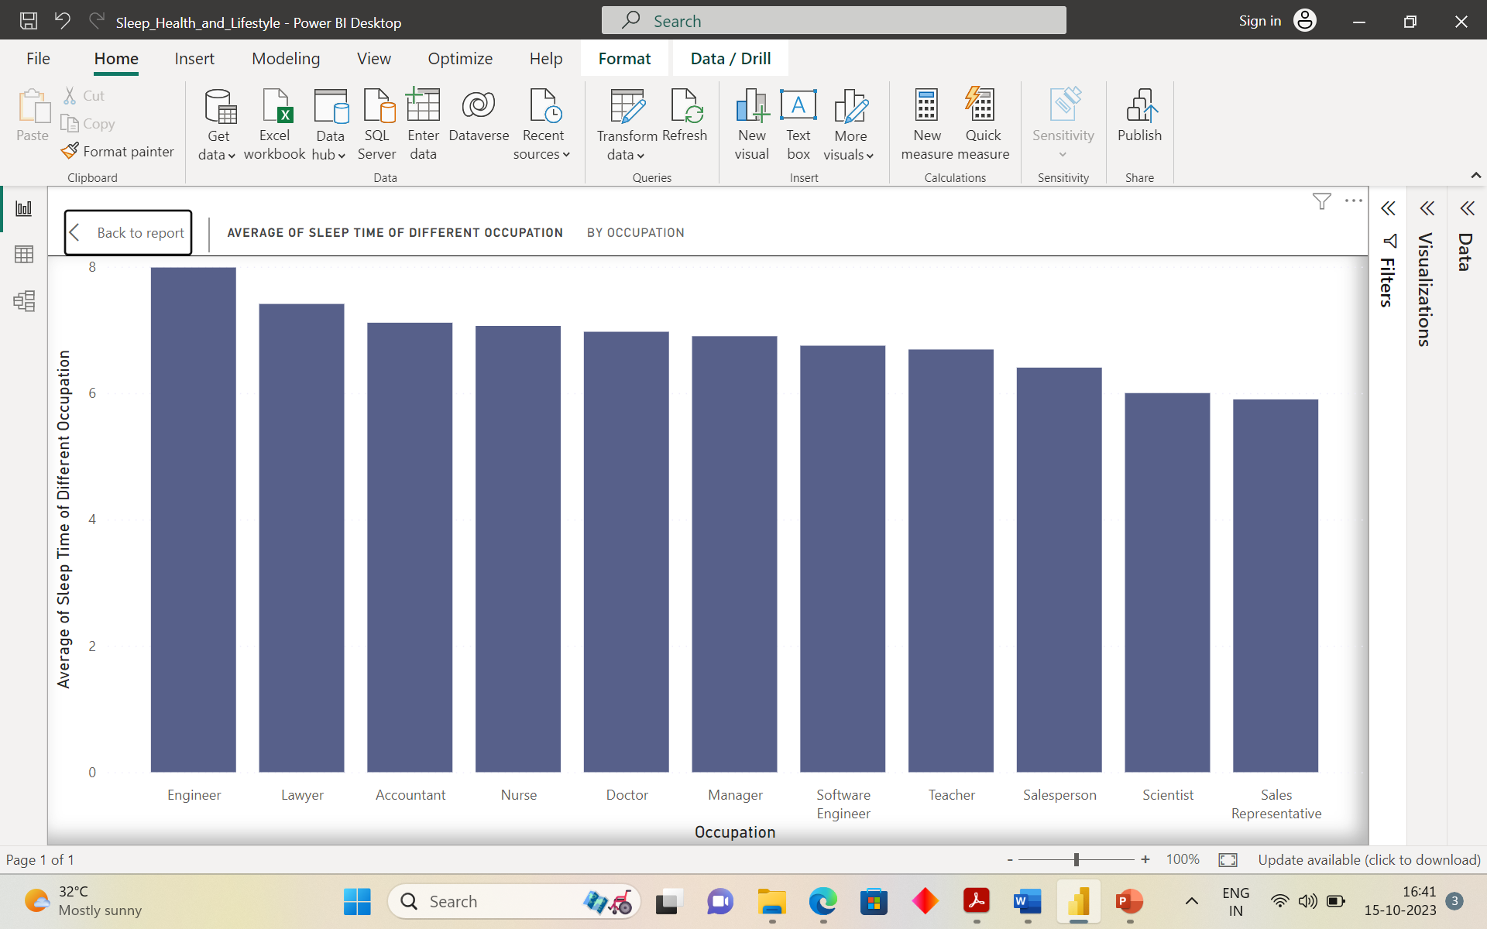
From the above two charts, we can analyze the average sleep duration based on the gender and the quality of sleep based on different occupation.
According to the above chart, the average sleep duration for the male is approximately 7.7 hrs, while for the female it is around 8.5 hrs.
In the bar chart it is evident that the occupation “Engineer” has the highest sleep quality among the different roles, while the occupation “Sales Representative” has the lowest sleep quality.

Slide 5
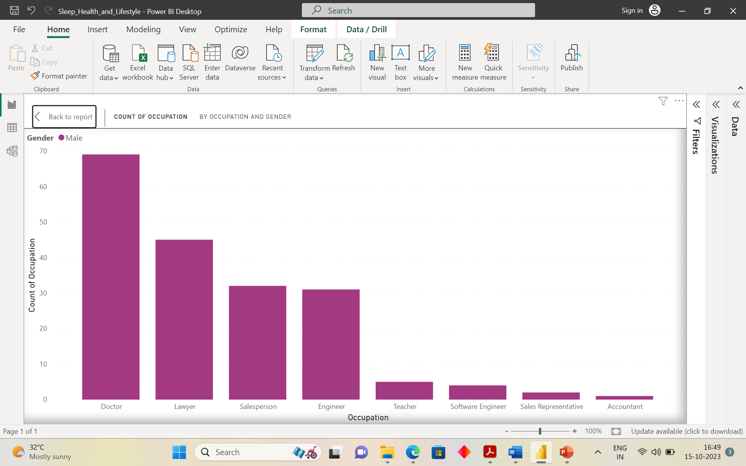
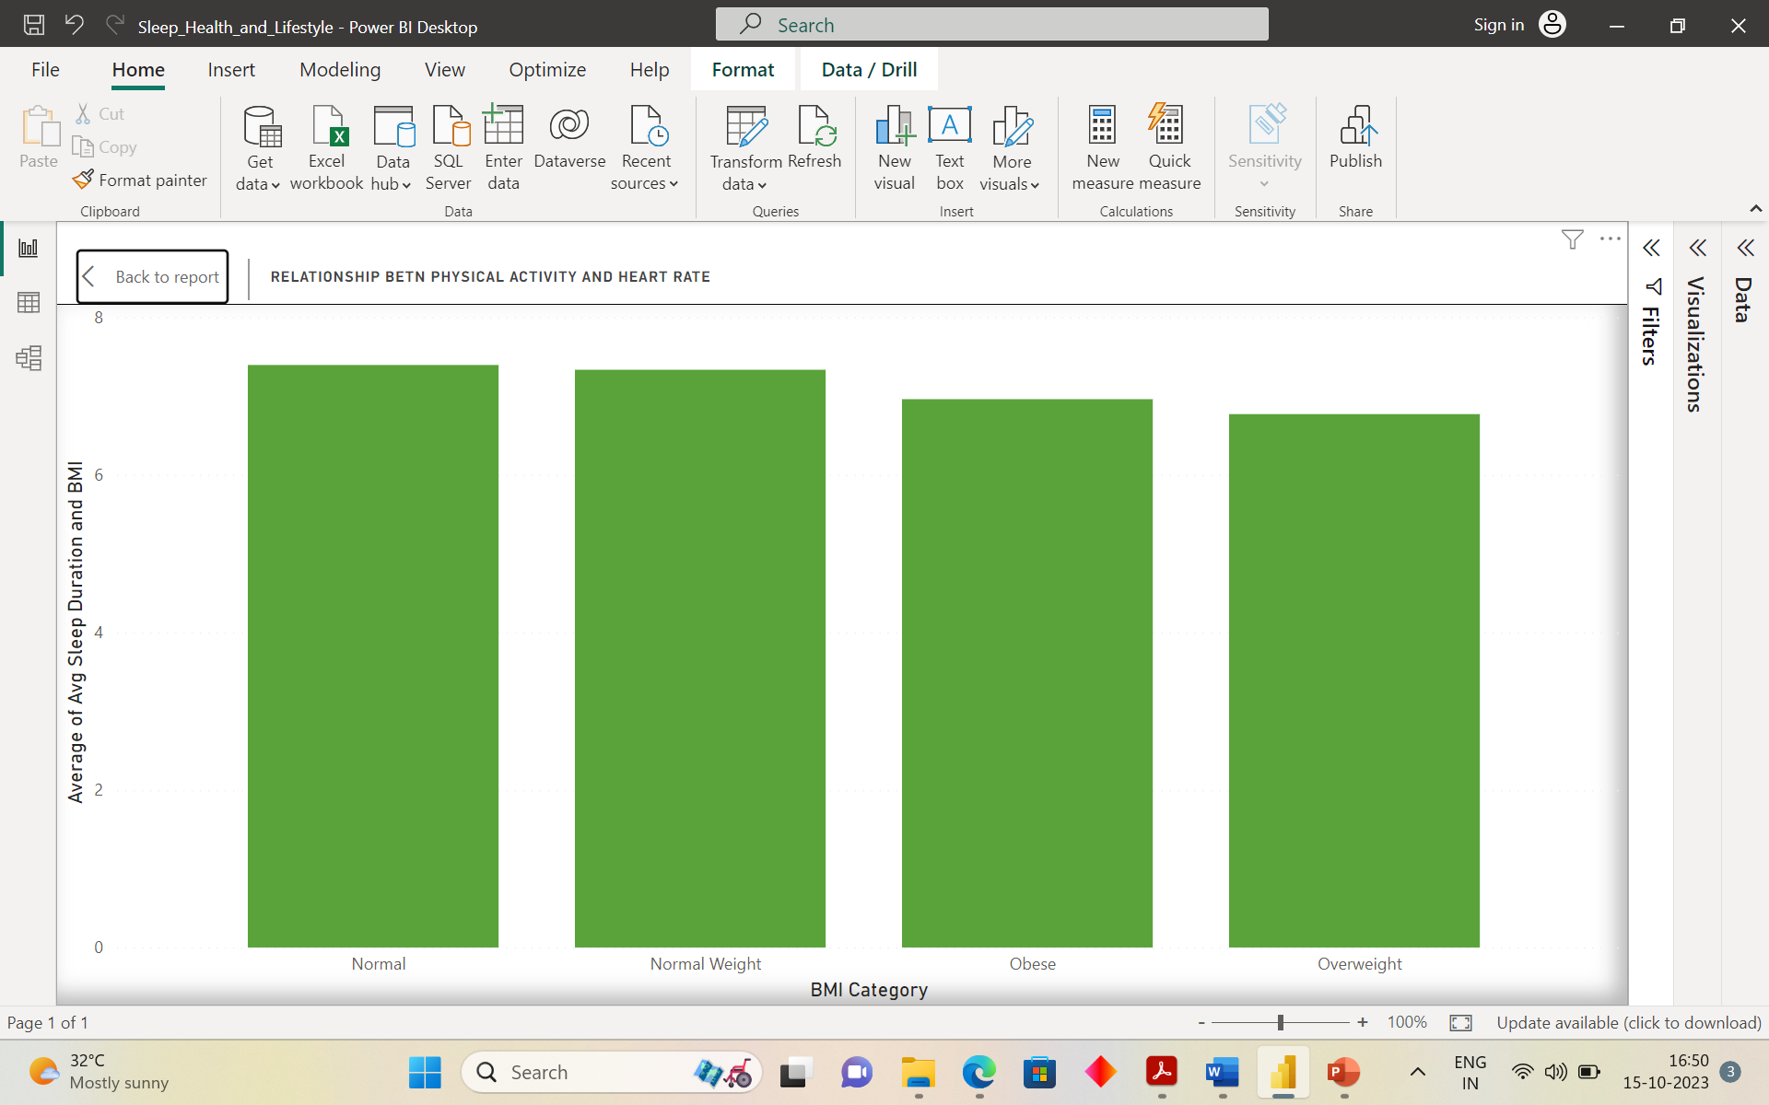
Regarding the dominance of the job role in the male gender, it can be seen that the “Doctor” profession is the most demanding job, while the “Accountant” role is relatively less dominant.
If we compare the relationship betn the average sleep duration and the BMI we can clearly see that the normal persons average sleep is more as compare to the overweight. So the more you become healthy the more is your average sleep duration.

Slide 6
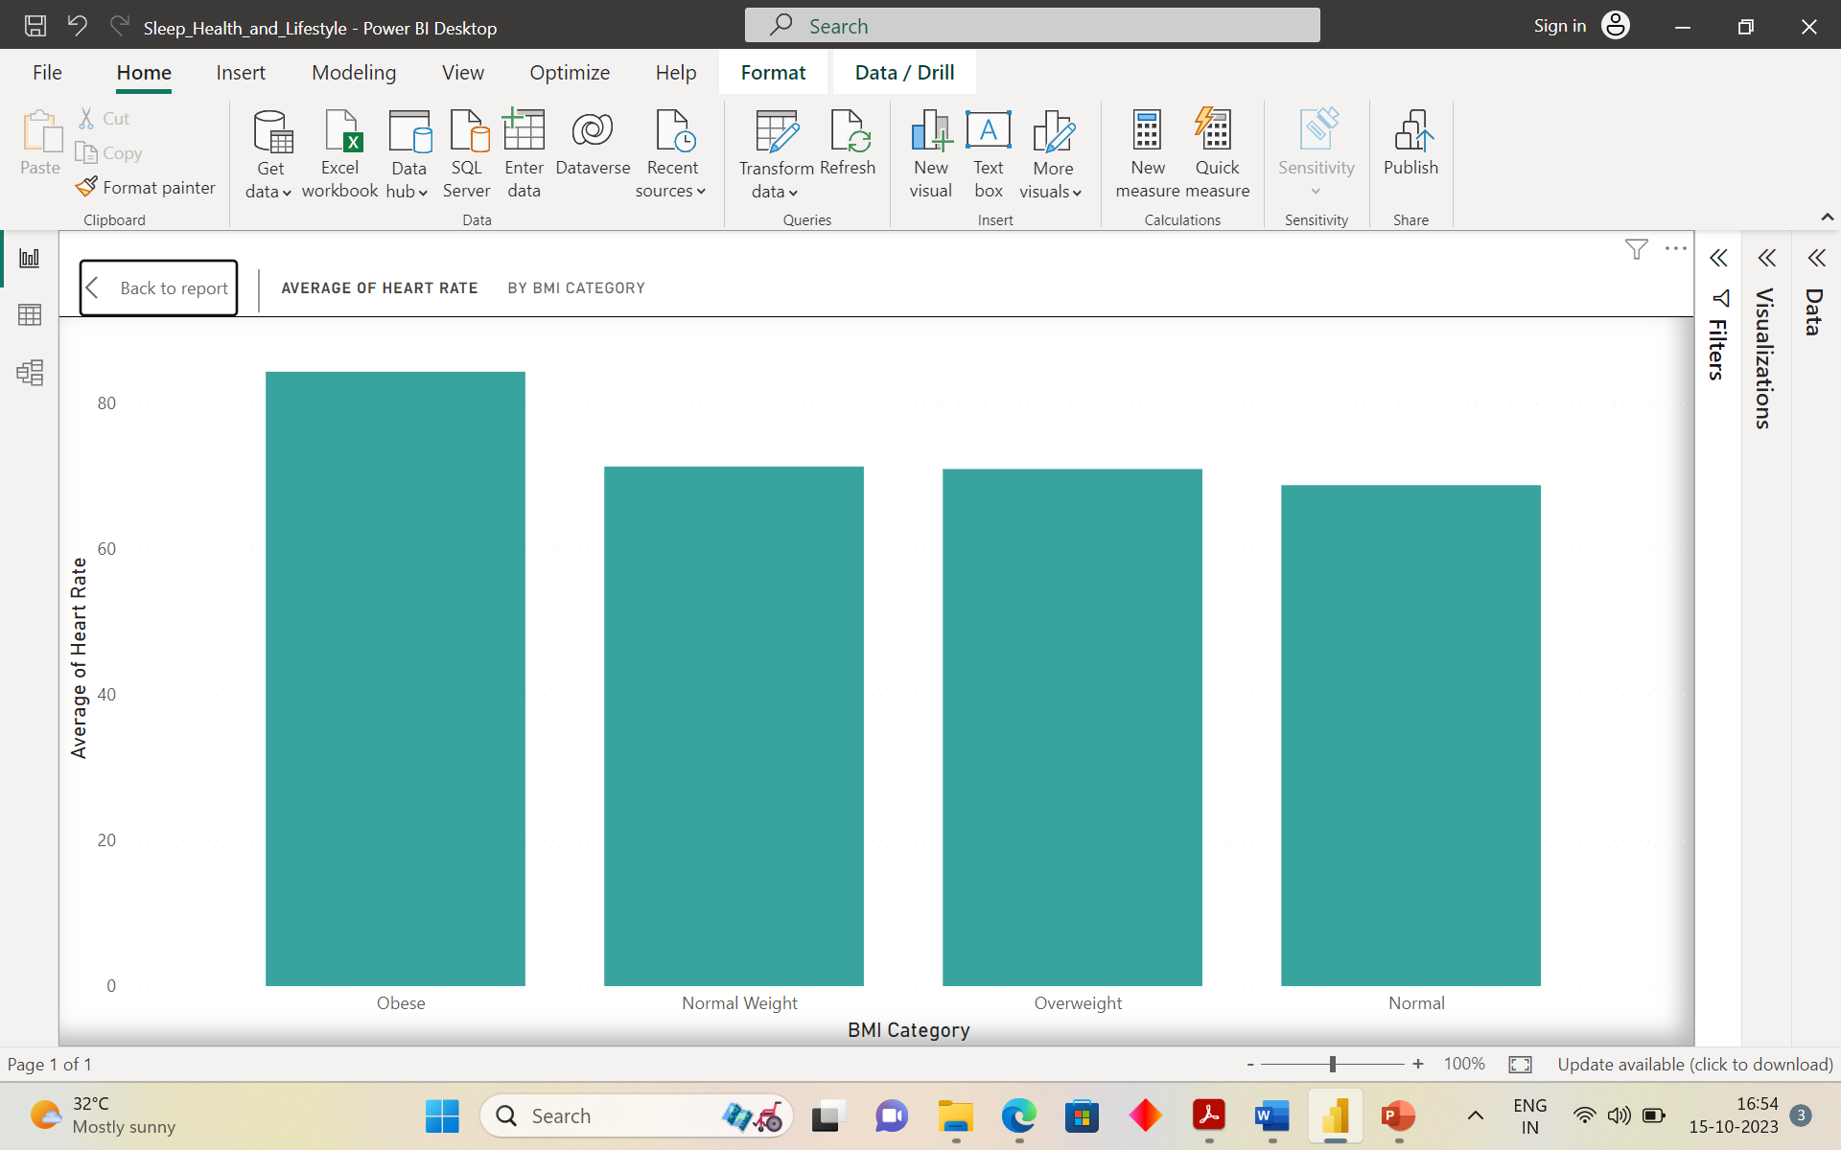
From the above graph, we observed that the obese person tend to have the highest heart rate as compare to the Normal person.
So as you start becoming healthy your average heart rate goes down, which is good for healt.

Slide 7
Conclusion :
This is my another project as a Data Analyst where the data is obtained from the Kaggle. The usual data processing steps are performed, including data cleaning. EDA (Exploratory Data Analysis ) techniques are applied to gain insight from the data, and the questions are formulated based on the analysis. Visualisation such as bar chart, pie chart and other types of chart are created to present the findings.

